Slide 1
Presentation on Project Report
Ratio Analysis of Nestle Group
By:
Amit Kumar, Hansraj college
Sukhpal, Hansraj College

Slide 2
Content
Introduction of Ratio Analysis
Company Profile
Objectives
Data Analysis and Interpretation
Findings
Recommendation

Slide 3
Introduction of Ratio Analysis
Ratio is an expression that compares of quantities related to each other.
A financial ratio or accounting ratio is a ratio of two selective numerical values that taken from an enterprise’s financial statements.
“The relationship of one item to another expressed in simple mathematical form is known as ratio.”
-Kennedy & Macmillan
Financial ratio are the tools for interpreting financial statement to provide a basic for valuing securities and appraising financial and management performance.

Slide 4
Uses:-
To workout the profitability.
To workout the solvency.
Helpful in analysis of financial statement.
Helpful in comparative analysis of the performance.

Slide 5

Company profile

Slide 6
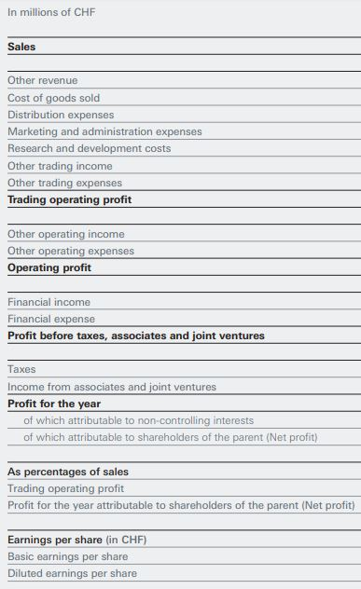
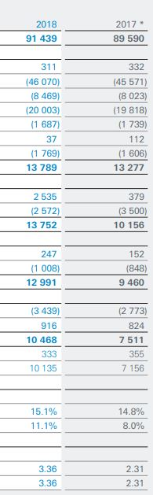
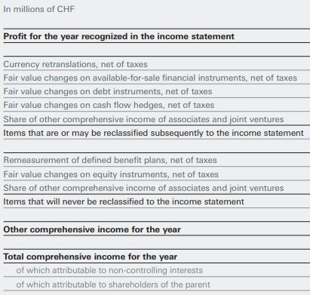
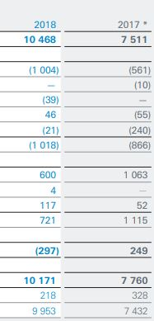
Income Statements
Income Statements

Slide 7
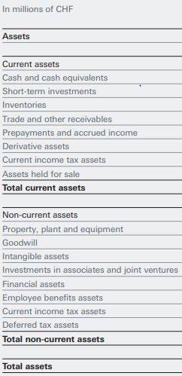
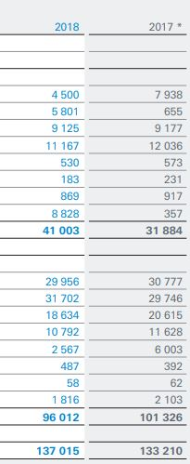
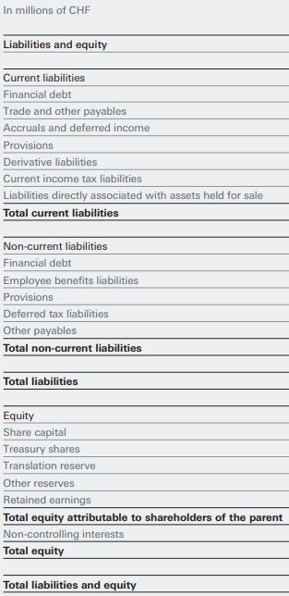
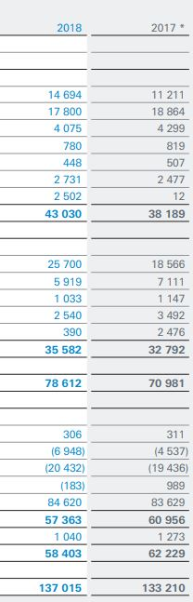
Balance Sheet

Slide 8
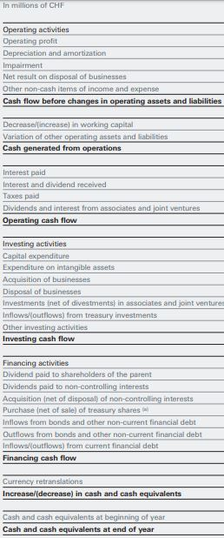
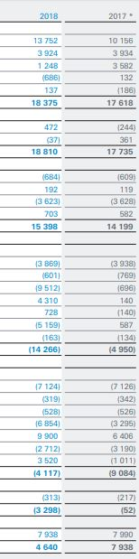
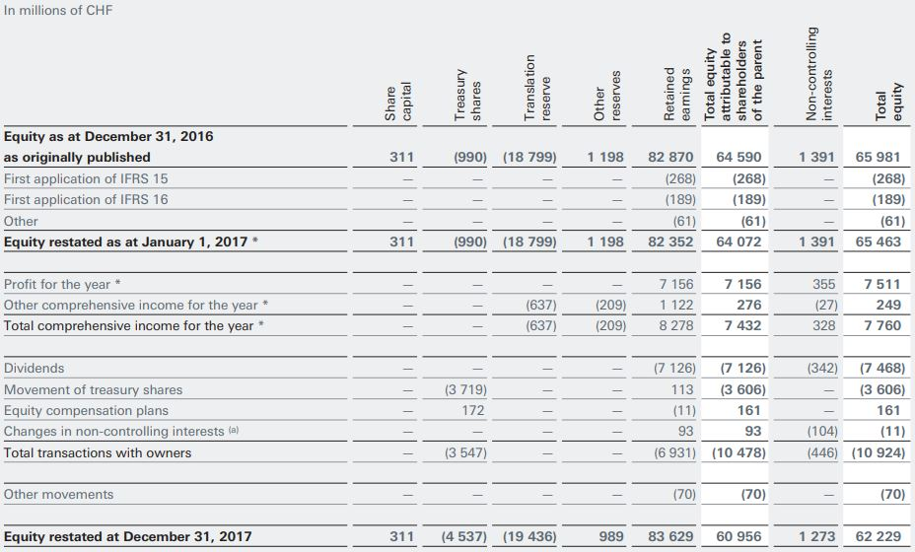
Statement of Changes in Equity
Cash Flow Statement

Slide 9
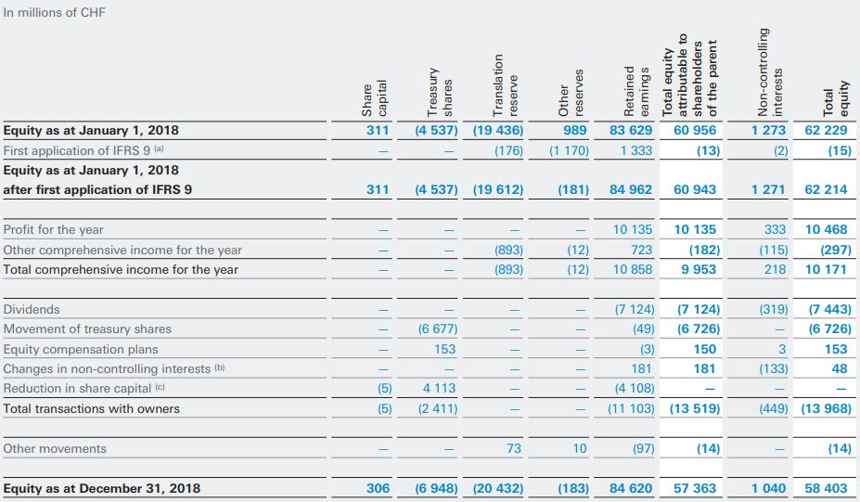
Statement of Changes in Equity

Slide 10
Objectives
To study the various Ratios of the organization.
To study the financial statements.
To know about the importance & uses of ratio in business.
To know about the solvency of the firm.
To study about the stability and profitability of the firm.
To study about the operational efficiency of the firm.

Slide 11
Ratio Analysis
Five Category of Ratios
Profitability ratios
Liquidity ratios
Debt ratios
Asset activity ratios
Market value ratios

Slide 12
Ratio Analysis
Profitability Ratios
Measures the overall effectiveness of the firm’s management.
 | 2018 | 2017
Gross Profit Margin | 0.114481 | 0.083837
Operation Profit Margin | 0.111233 | 0.086684
Net Profit Margin | 0.108849 | 0.082956
Return On Assets | 0.074233 | 0.058299
Return On Equity | 0.174152 | 0.124797

Slide 13
Ratio Analysis
Profitability Ratios

Slide 14
Ratio Analysis
Liquidity Ratios
Measure the ability of the firm to meet in short-term financial obligations.
 | 2018 | 2017
Current Ratio | 0.952893 | 0.8349
Acid-Test Ratio | 0.740832 | 0.759695

Slide 15
Ratio Analysis
Liquidity Ratios

Slide 16
Ratio Analysis
Debt Ratios
Measure the relative size of the firm’s debt load and the firm’s ability to pay off the debt.
 | 2018 | 2017
Debt Ratio | 0.501624 | 0.426057
Debt to Equity Ratio | 1.176823 | 0.912035
Times Interest Earned Ratio | 46.65596 | 23.67683

Slide 17
Ratio Analysis
Debt Ratios

Slide 18
Ratio Analysis
Asset Activity ratios
Help Assess how effectively the firm is using assets to generate sales.
 | 2018 | 2017
Average Collection Period | 44.57567 | 49.03605
Inventory Turnover Ratio | 10.02071 | 9.76245
Fixed Asset Turnover Ratio | 10.35784 | 250.9524
Total Asset Turnover Ratio | 0.667365 | 0.672547

Slide 19
Ratio Analysis
Asset Activity ratios

Slide 20
Ratio Analysis
Market Value
 | 2018 | 2017
Price to Earnings Ratio | 213.6128 | 189.8556
Market Book Ratio | 36.40375 | 22.67443

Slide 21
Ratio Analysis
Market Value

Slide 22
Data Analysis and Interpretation

Slide 24
Findings

Slide 25
Recommendation

